Slide 1



Università degli Studi di Salerno
STM32 powered IoT Security project
Maria Caterina D’Aloia
Giorgio Colella
Student
Student

Slide 2


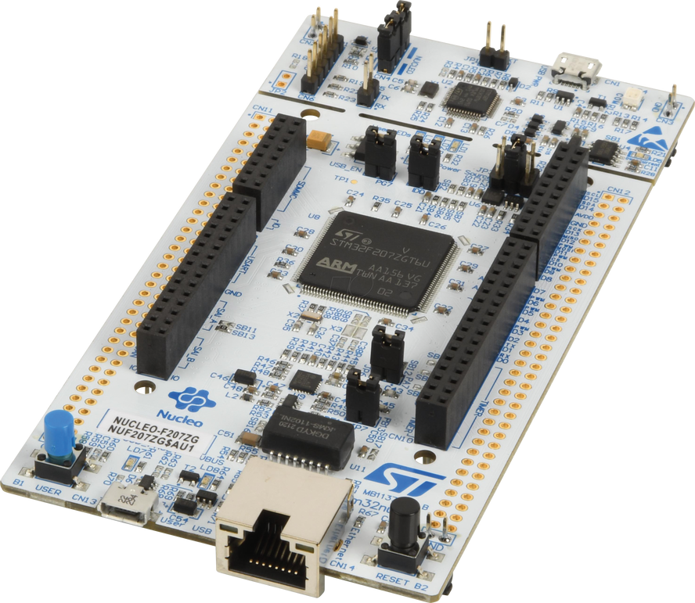
Requirements analysis
IoT in the world
STM32 board
Components and Security in STM32 microcontrollers
Index
AWS IoT Core
More AWS services
Demo

Slide 3
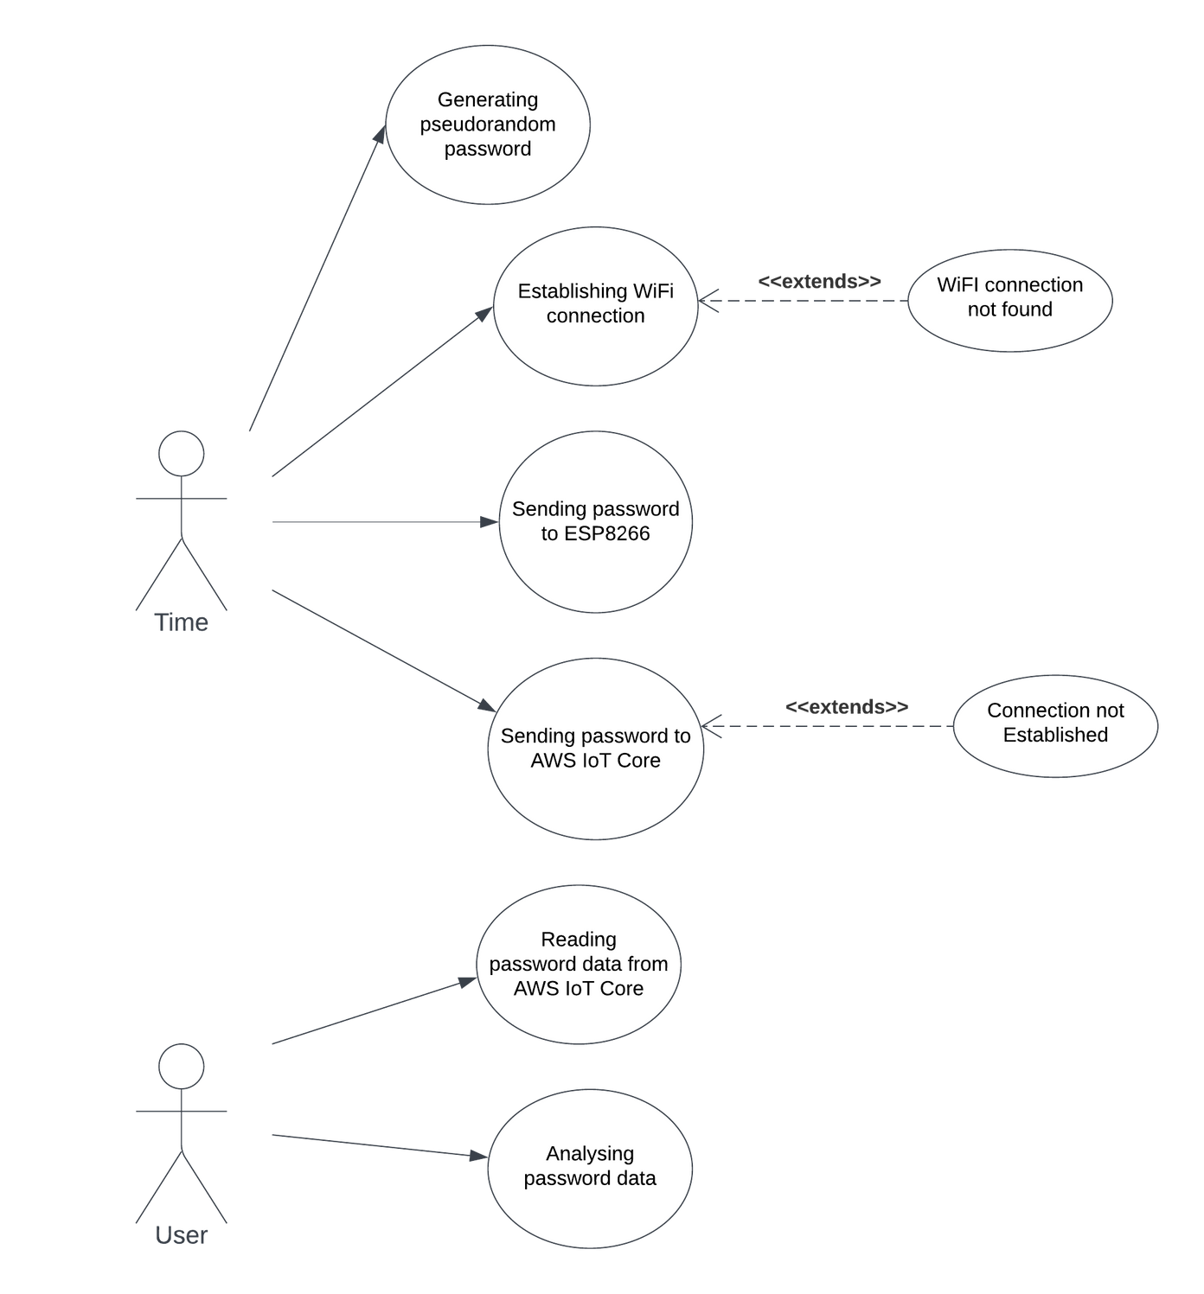
Use Cases

Slide 4
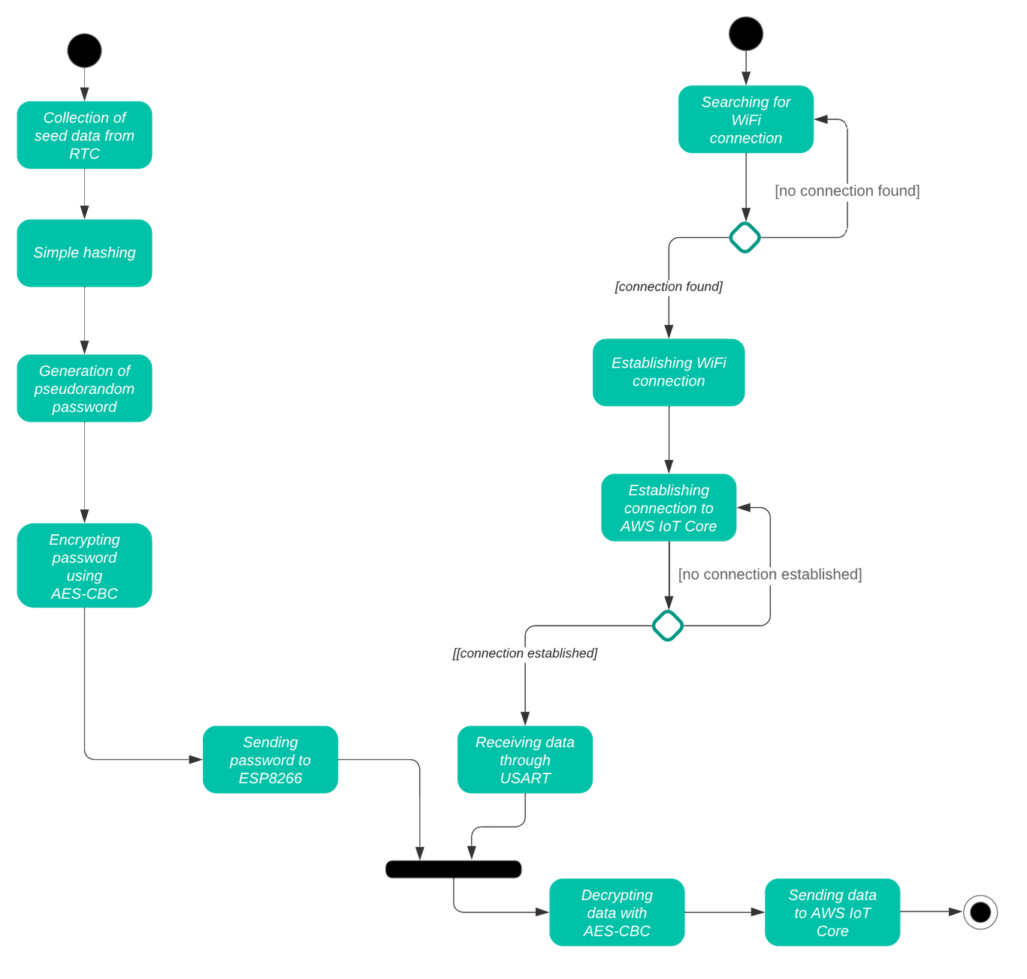
Activity Diagram

Slide 5


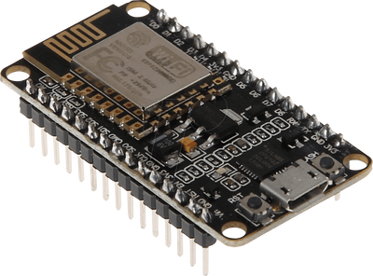
IoT devices in the world
29.42 billion
Connected IoT devices in 2030 (estimated)
29.42 billion
15.14 billion
Connected IoT devices in 2023
15.14 billion
8.6 billion
Connected IoT devices in 2019
8.6 billion

Slide 6

STM32 board | Arduino board
Advanced Features Performance Advanced Peripheral Support More Professional Development Environment Scalability Cost-Effectiveness for Complex Projects | Ease of Use Large Community and Resources Low Cost Rapid Prototyping
VS

Slide 7




IoT attacks
IoT attacks in 2018 were 32 milion
IoT attacks in 2022 were 112 milion
More than 25% of all cyberattacks against businesses will involve IoT in a few years
All data from Statista

Slide 8


General STM32 security capabilities
 | Threats | Defense
Code injection | Theft of sensitive information, disruption of operations or exploitation of vulnerabilities for further attacks | Code signing and verification and secure boot
Side-Channel Attacks | Enables attackers to decrypt sensitive information or impersonate legitimate users | DPA resistance techniques, randomizing execution times and secure cryptographic algorithms with constant-time execution
Physical tampering | Unauthorized access to sensitive data, modification of the firmware or configuration settings, disruption of operations,etc... | Secure enclosures, tamper-evident seals, and anti-tamper sensors
Network attacks | Interception or manipulation of sensitive data, unauthorized access to network-connected systems or services or disruption of communication channels | SSL/TLS and mutual authentication mechanisms to prevent man-in-the-middle attacks

Slide 9


Components and Security in the STM32U575ZIT6Q
HAL
ARM TrustZone
RCC
Password-protected debug
RTC
HASH hardware accelerator
USART
96-bit unique ID (UID)
512-byte OTP (One-Time Programmable) memory

Slide 10






Why AWS IoT Core?
SDK
MQTT and TLS 1.2
Certificates and keys
Rules engine
Cost-effective
“We're not competitor obsessed, we're customer obsessed. We start with what the customer needs and we work backwards.”
Jeff Bezos

Slide 11


Amazon Timestream
Allowing to store data and query it with SQL
Amazon Managed Grafana
Allowing to visualize data in an efficient and effective way
Other AWS services
Testing and Monitoring
Allowing to test the effectiveness of the different AWS functionalities

Slide 12
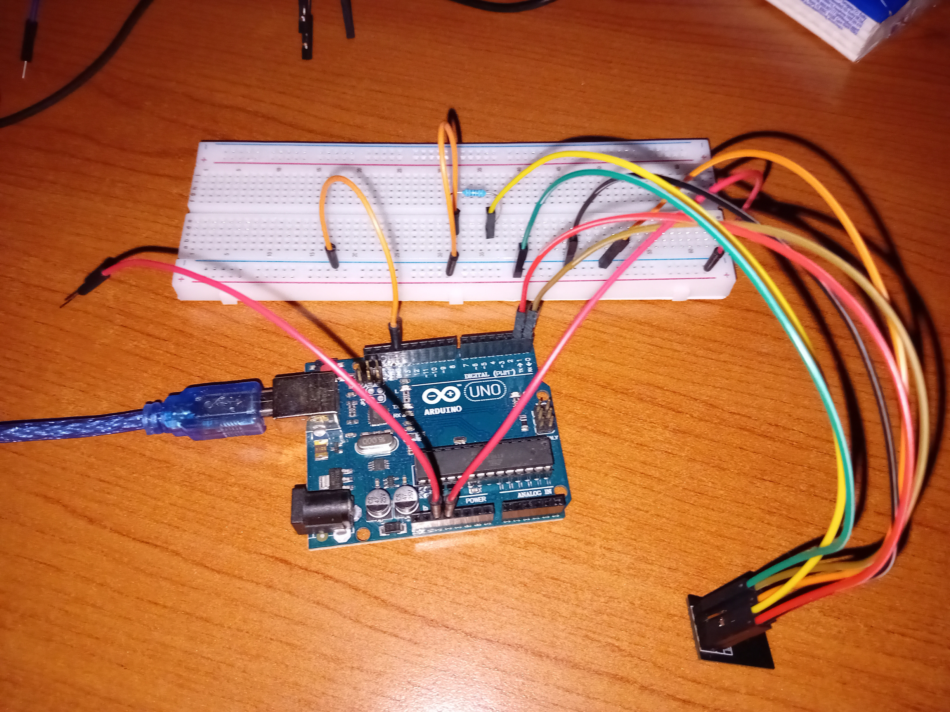
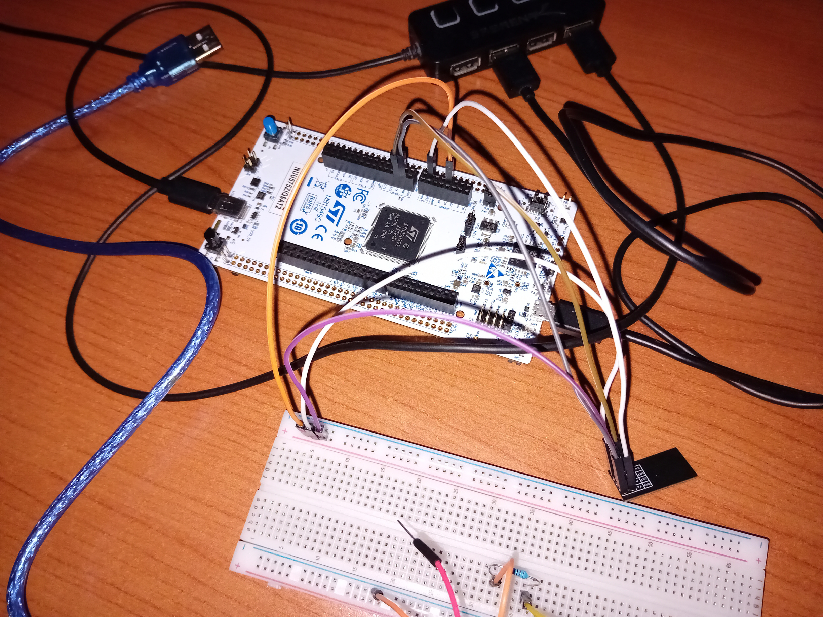
Setup

Slide 13
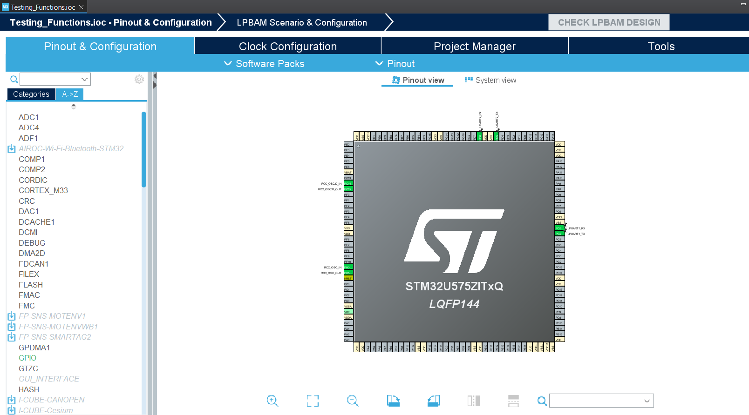
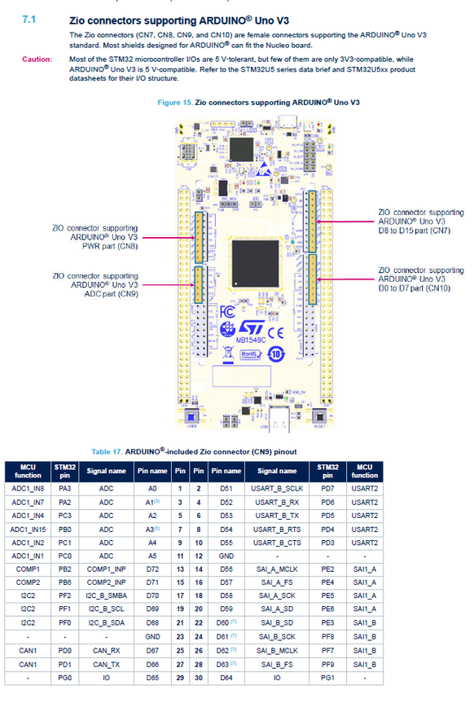
Tools and documentation

Slide 14
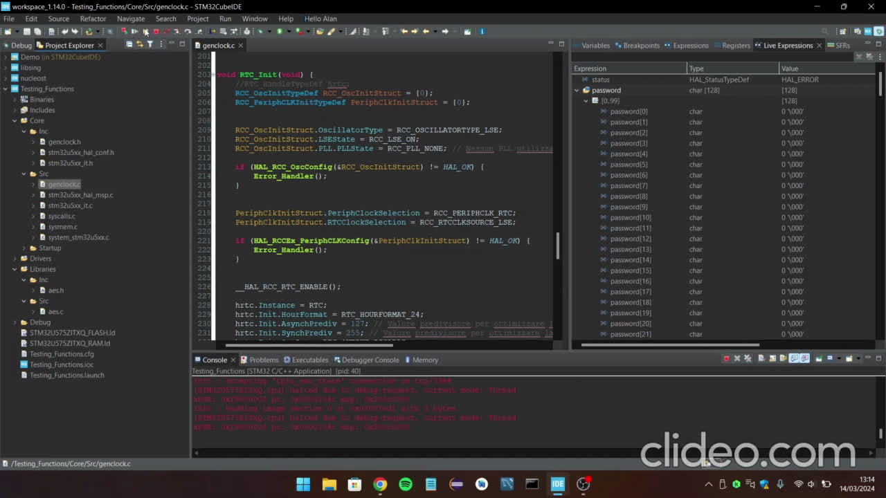
Demo

Slide 15
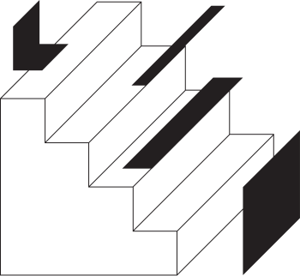
Thank you for your attention

